Slide 1
Camera IQC test list
For Camera IQC general test item
ND's test item | Algorithm | Source | SPEC | Test chart | Remark
Defect pixel test | each pixel compare to neighbor 7*7 block | refer to Omni OQC | <20 pixel | White chart | RAW
SFR | Specfic SFR formula (calculate the B/W bondary total 16 blocks) | ND own code | 0.5F >0.3 @1/2NY | Omni SFR chart | BMP
 |  |  | 0.2F >0.35 @1/2NY
Uniformity | Mean[Corner]/Mean center | refer to Omni OQC | 0.2F >0.6 | White chart | RAW
Color response | All pixel mean of each color | refer to Omni OQC | 0.9<R/G<1.1 | White chart | RAW
 |  |  | 0.5<B/G<0.9
Dust/Spot test | 4*4 compare to neighbor 9*9 block with each divided color | refer to Omni OQC | 0.07 | White chart | RAW
Dark response | The average of hole image | refer to Omni OQC | Avg <12 | Dark | RAW
Contrast | Calculate the difference of boundary black and edge black | ND own rule | 12(TBD) | (TBD) | BMP

Slide 2
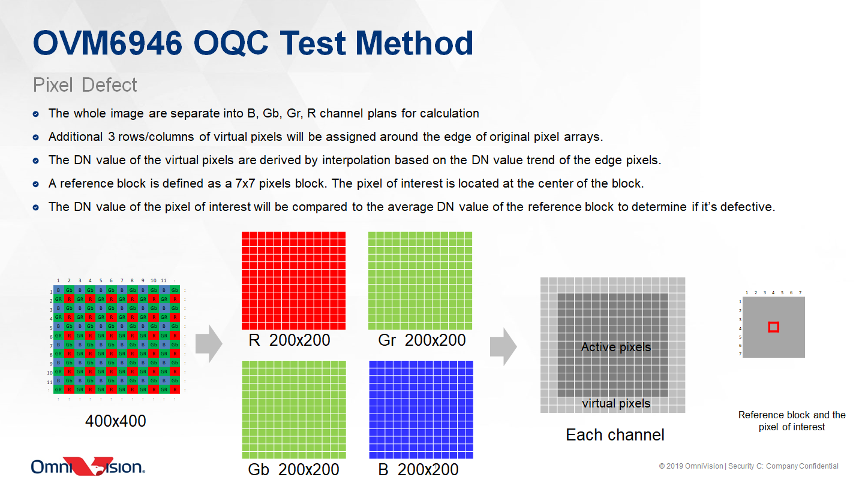
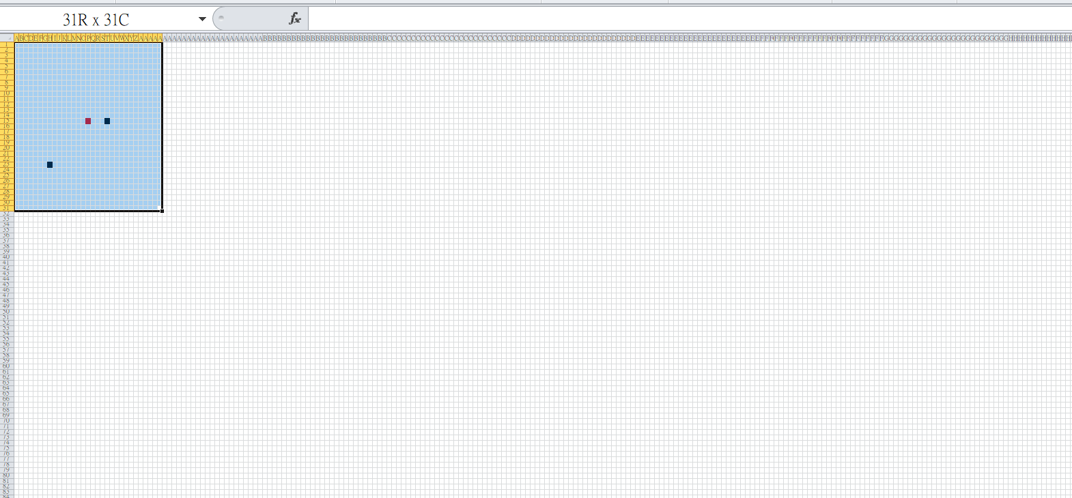
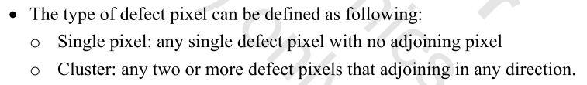
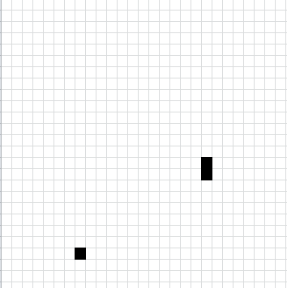
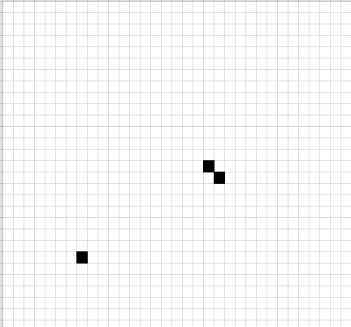
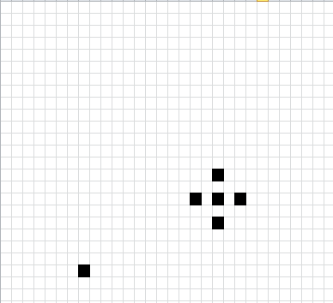
Defect Pixel test
Virtual pixels: ND will implant own method to build up the edge pixel calculation method
Defect pixel count
Test target pixel
Defect pixel
7*7
array
(moving
Window)
Bright: [(Test target pixel)- mean (array)]
>20%
[(mean (array)]
Dark: (Test target pixel)- mean (array)] >20DN

Slide 3
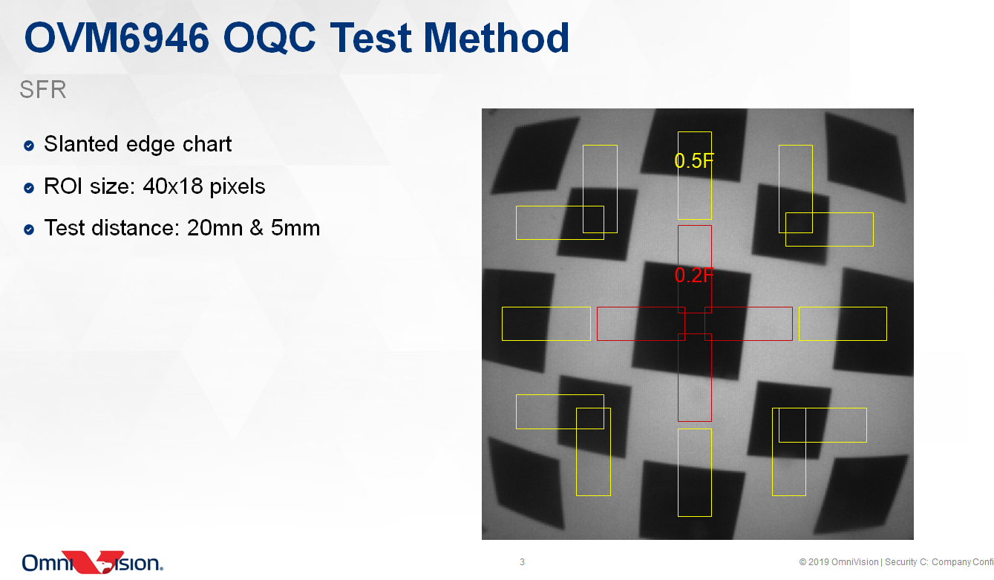
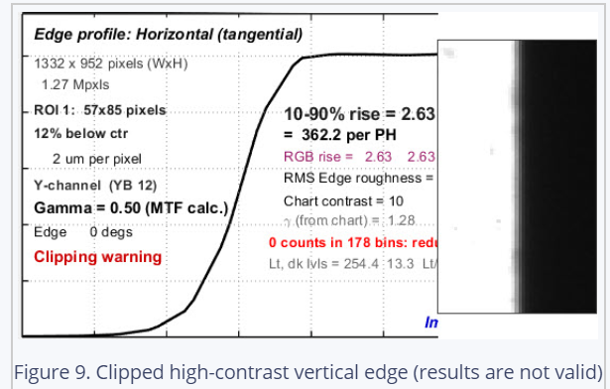
SFR test

Slide 4
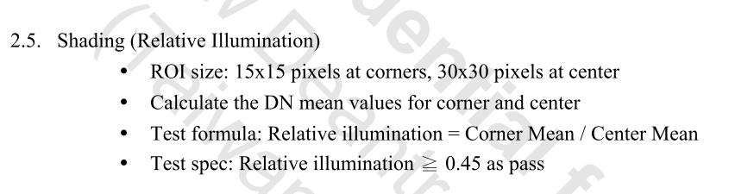

Uniformity
Corner LU
Corner RU
400*400
15*15
15*15
Mean
Mean
30*30
≥ 0.45
≥ 0.45
Mean
Mean
Mean
Mean
≥ 0.45
≥ 0.45
Mean
Mean
15*15
15*15
Corner LD
Corner RD
Note: The mean of corner calculated separately

Slide 5
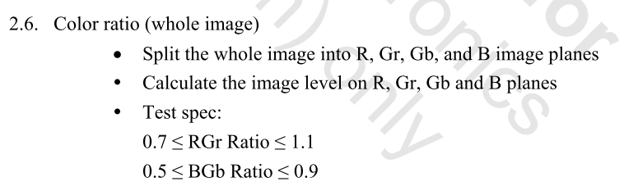
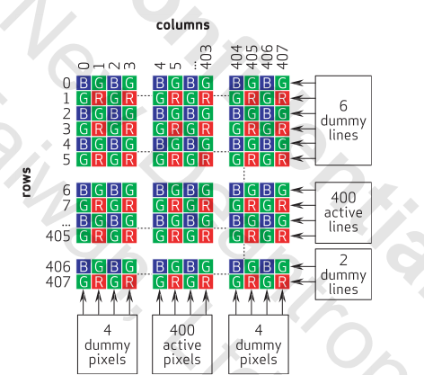
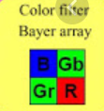
Color response
Calculate the average of Gr pixel, R pixel, Gb pixel, B pixel in whole frame and check the ratio as the formula shown.

Slide 6
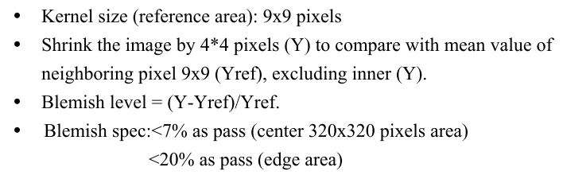
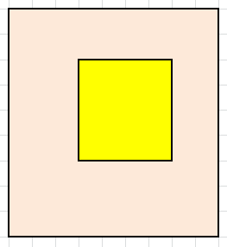
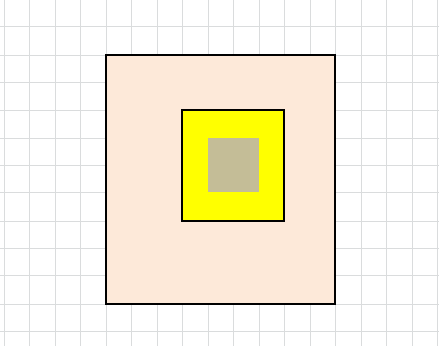
Dust/Spot test
400*400
320*320
Yref
9*9
Yref
9*9
Y
4*4
Y
4*4
Dust/ contamination 2*2
Note: This item could detect several pixels dust/contamination.

Slide 7
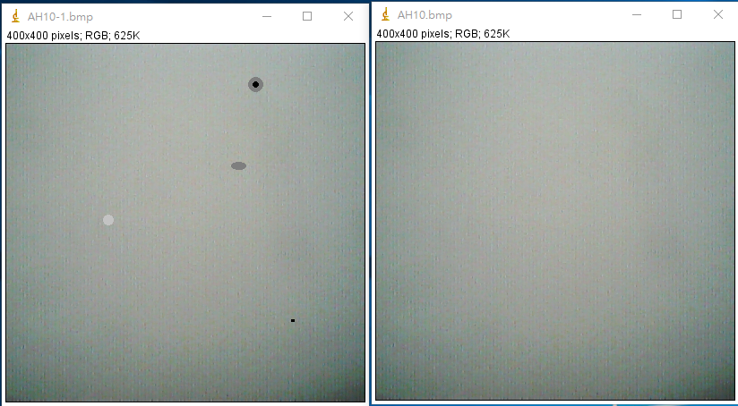
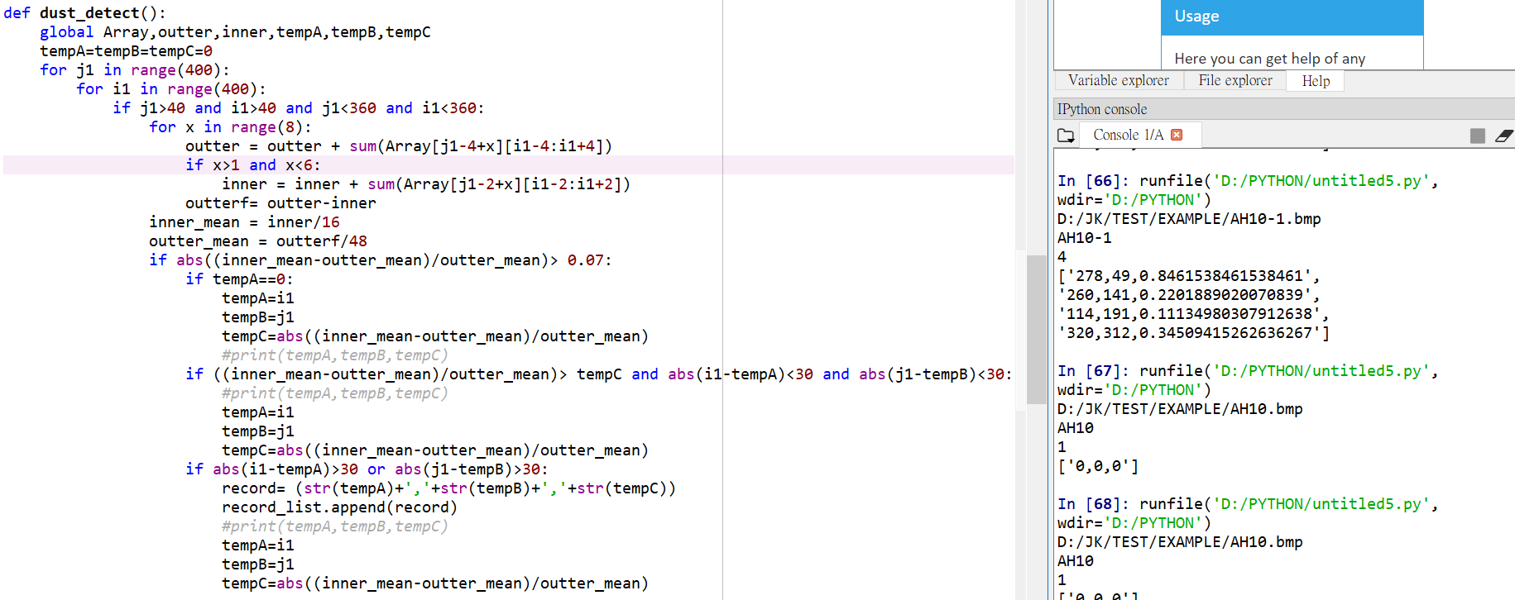
Dust/Spot test
AH10-1
AH10
(278,49)
(260,141)
(114,191)
(320,312)
8*8

Slide 8
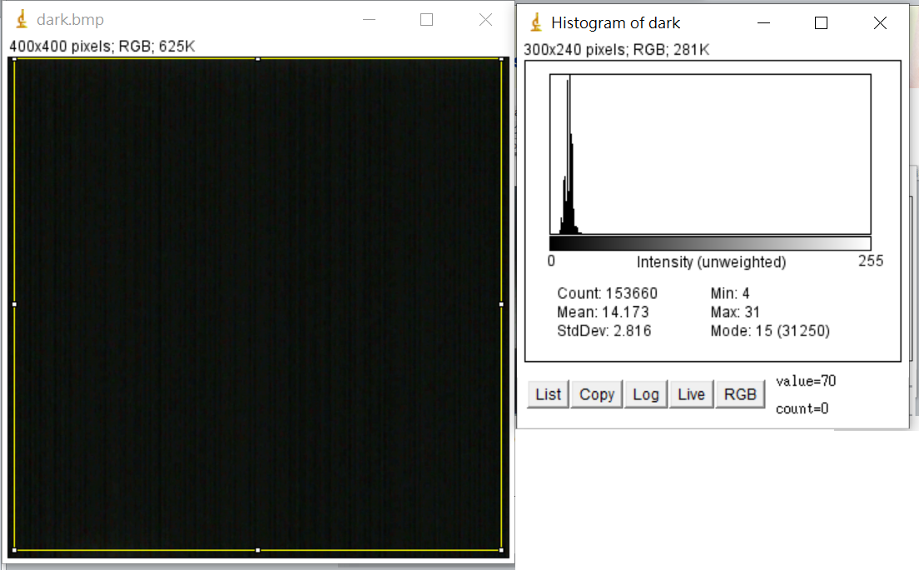
Dark response
Calculate the average and check the hot spot.

Slide 9
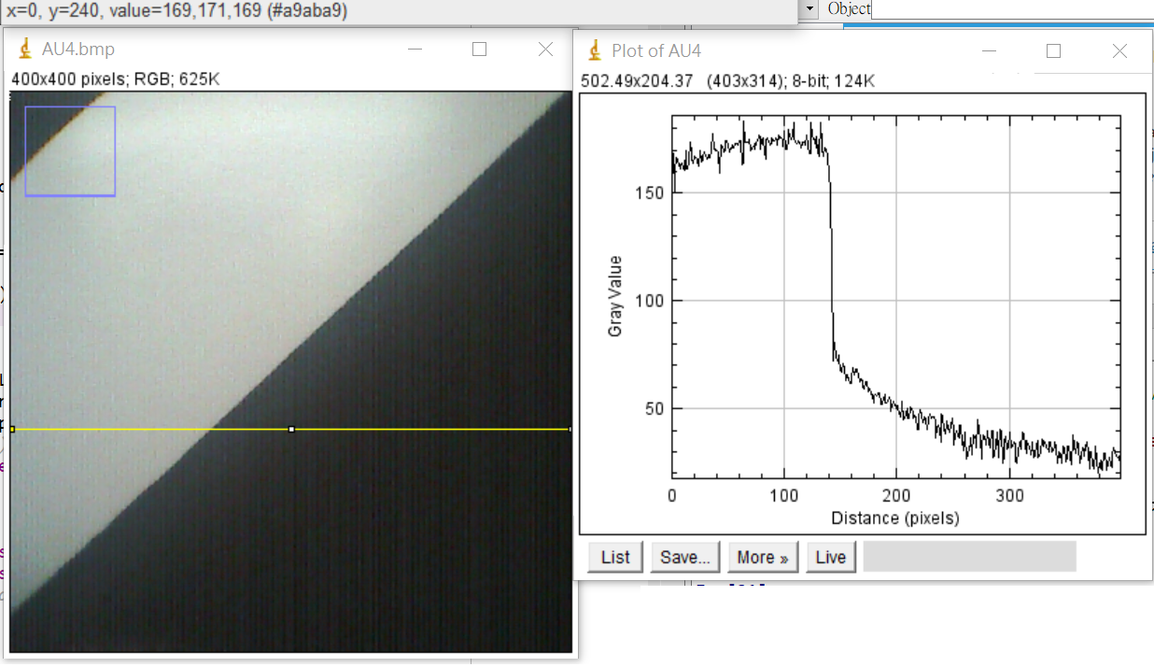
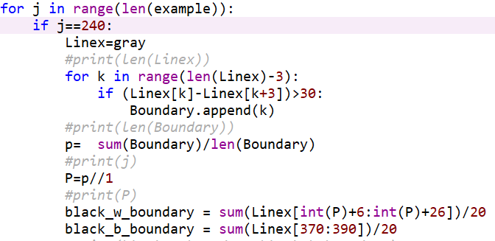
Contrast test
Line 240
black_w_
boundary
black_b_
boundary
There step:
1.Select the target line
2.Find the boundary
3.Calculate the difference between black_w_boundary and black_b_boundary
①
②
③

Slide 10
Endoscope OQC test list
For finish sample of the hand piece endoscope
Item | Algorithm | Source | SPEC | Test chart | Remark
Sensitivity | Maximum of lighting condition and 33ms exposure time & 1XGain | ND'own rule | Avg >200 @ 1lum | White Chart
White Balance | Adjust R/G/B gain to be equal, to check if the R,G,B value is the same | ND'own rule | <3% TBD | White Chart
SFR | Specfic SFR formula (calculate the B/W bondary) | ND own code | 0.2F >0.5 @1/2NY | B/W chart
Uniformity-2 | AVG[Up/Down/Left/Right ] divided AVG[Center] | refer to ACT | <15% (TBD) | White Chart
Color response-2 | Count the mean of R/G/B value, and check if the value is under the SPEC | refer to ACT | TBD | Red Chart
 |  |  | TBD | Green Chart
 |  |  | TBD | Blue Chart
Dust/Spot | each pixel compare to neighbor 7*7 block | refer to Omni | 0.07 | White Chart
Dark response | Check the mean of dark level | refer to Omni | Avg <12 | Dark
Noise | Standard division of total image | refer to J&J | TBD | Dark
 | Standard division of two frames difference in each pixel | refer to J&J | TBD | Dark
Stray light* | Check the dark uniformity | ND'own rule | TBD | Dark Box with lighting

Slide 11
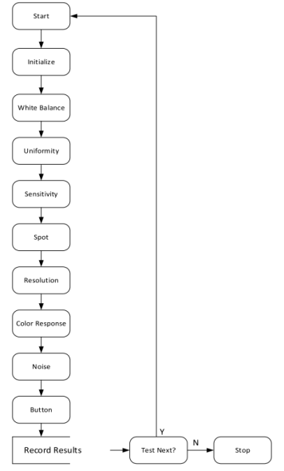
ACT FCO test list
Procedure
Item | Lighting | Target | Image | Algorithm/Correction | SPEC | Failure Cause | Remark
White Balance | DUT Led | White | Color | RGB gain | 1<R<1.34 1<G<1.1 1<B<1.63 | LED Sensor Assembling | Partially understand
Uniformity | DUT Led | White | Gray | Sigma1-high removed Center, Edge, Corner | Min/AVG (TBD) | Sensor Assembling | Partially understand
Sensitivity | DUT Led | White | (TBD) | AEC R32Bank0 [0x5020] | 90~340 | LED Sensor Assembling | Partially understand
Spot | DUT Led | White | (TBD) | After sensitivity test | Manually inspect? | Sensor Assembling | Partially understand
Resolution | DUT Led | MTF | (TBD) | Angled 5~10degree | >40 @MTF50 >115 @MTF10 | Camera lens Assembling | Rarely understand
Color response | DUT Led | Red Blue Green | Color | Average by FPGA | @R target 930>R>870, 360>G>300, 275>B>175 @G target 632>R>546 930>G>870 625>B>475 @B target 425>R>275 525>G>375 930>B>870 | LED Sensor | Partially understand
Noise | Dark | None | Gray | Off all image adjusted Function Sigma1-low removed Check SNR of 200*200 | 65>SNR>55 | Sensor | Rarely understand
Button | None | None | None | Check the EEprom | Value changed | Assembling | Fully understand
Stray light | DUT Led | Dark Box | Gray |  |  | Assembling | Partially understand
Test
Item
Procedure

Slide 12
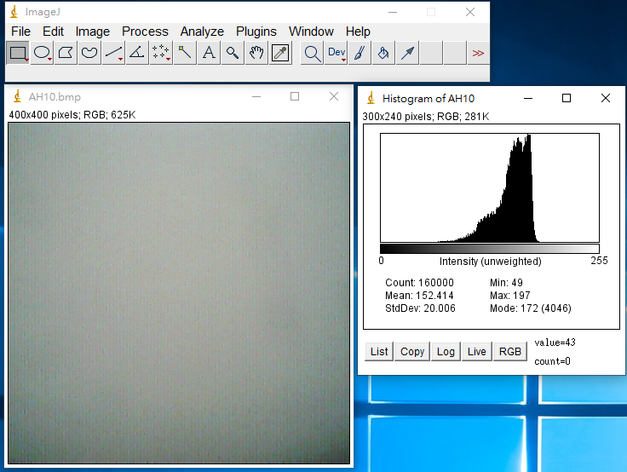
Sensitivity
Fix the light intensity and to get the mean of whole picture.
Note: Fix the luminance @ 1lumin and exposure time and gain to check the mean level

Slide 13
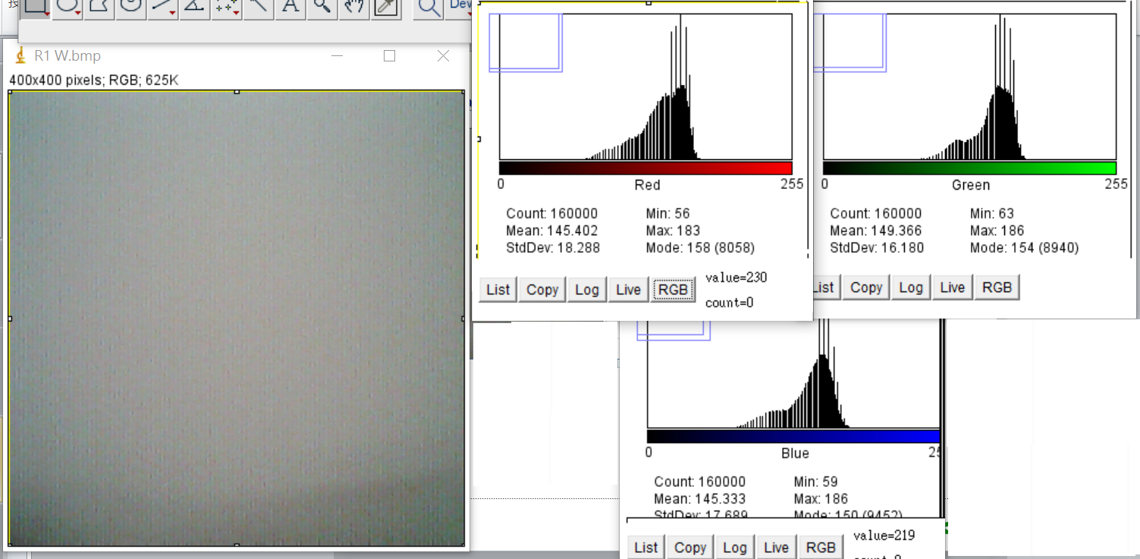
White balance
R,G,B (diff) < 3% (TBD)
Note: Separated and calculated average of each R,G,B channel individually

Slide 14
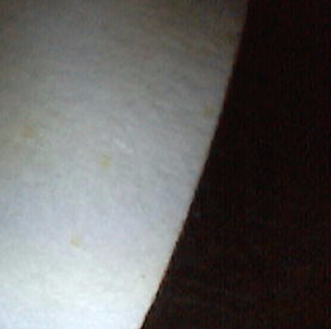
SFR test
Note: Calculated the single part of B/W boundary of center part.

Slide 15
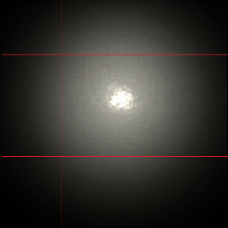
Uniformity-2
100
300
Edge up
100
Edge
Left
Edge
Right
Center
300
Edge down
Center: AVG(X:100~300,Y:100~300)
Edge Left: AVG (X:0~100,Y:100~300)
Edge Up: AVG (X:100~300,Y:0~100)
Edge Right: AVG (X:300~400,Y:100~300)
Edge Down: AVG (X:100~300,Y:300~400)
Uniformity: Edge Left / Center
Edge Up/ Center
Edge Right/ Center
Edge Down) / Center

Slide 16
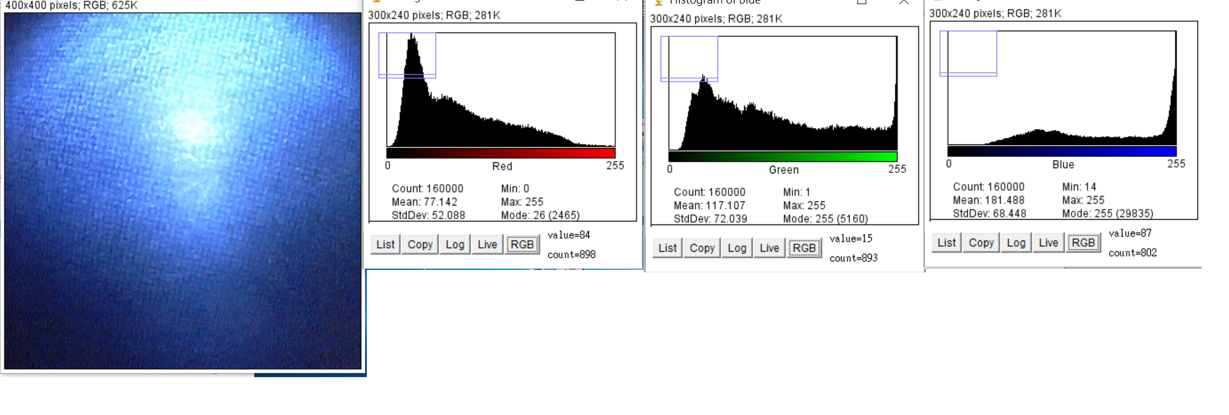
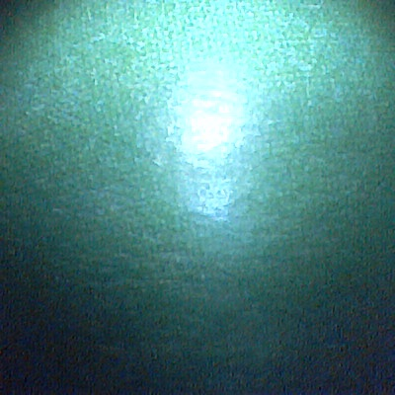
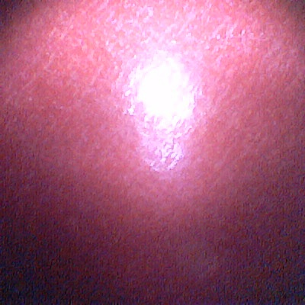
Color response-2
Note: Calculated the average of the R/G/B data in R/G/B picture (AWB off)

Slide 17
Dust/Spot test
400*400
320*320
Yref
9*9
Yref
9*9
Y
4*4
Y
4*4
Dust/ contamination 2*2
Note: This item could detect several pixels dust/contamination.

Slide 18
Dust/Spot test
AH10-1
AH10
(278,49)
(260,141)
(114,191)
(320,312)
8*8

Slide 19
Dark response
Note: Calculate the average and check the hot spot.

Slide 20
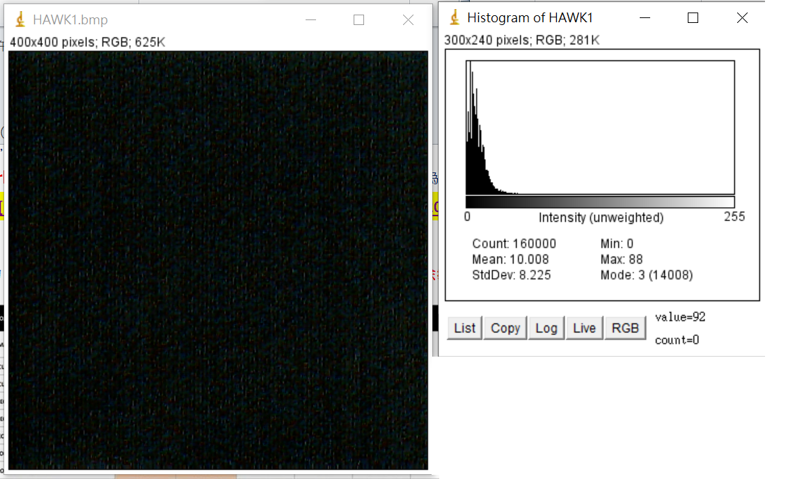
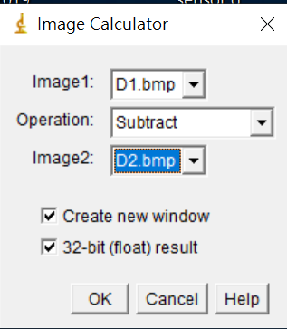
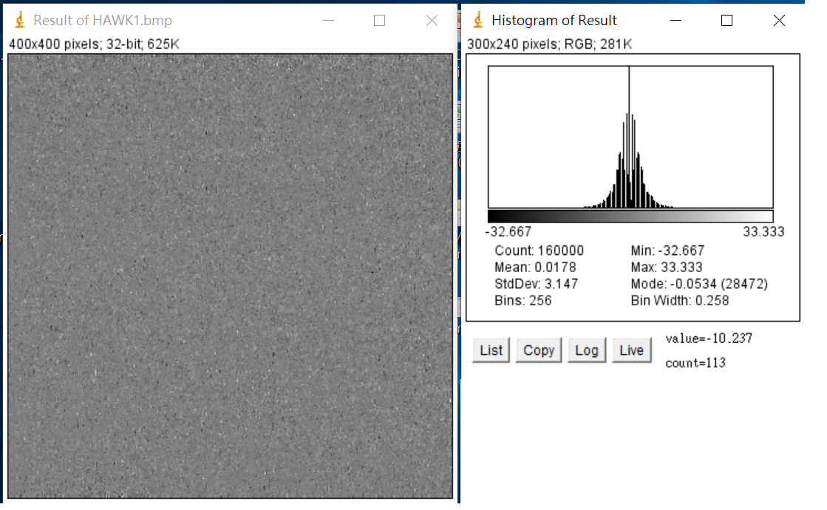
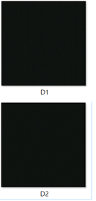
Noise test
Total noise(RMS)
Two
frame
Temporal noise(RMS)

Slide 21
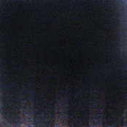
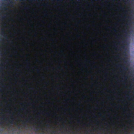
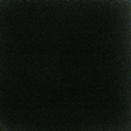

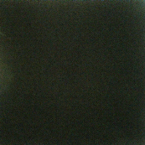
Stray light test item
Test condition: lighting in dark box
Defect lens sample
Normal lens sample
Failed-AP8
Failed-AR1
Passed-AT3
Passed-BP8
Failed-CB9
Center: AVG(X:100~300,Y:100~300) >25 fail
Edge Left: AVG (X:0~100,Y:100~300) >25 fail
Edge Up: AVG (X:100~300,Y:0~100) >25 fail
Edge Right: AVG (X:300~400,Y:100~300) >25 fail
Edge Down: AVG (X:100~300,Y:300~400) >25 fail
Uniformity: (Edge Left+ Edge Up+ Edge Right+ Edge Down)/ 4 / Center
100
300
Edge up
100
Edge
Left
Edge
Right
Center
300
Edge down

